Slide 1
MPCA Analytics Project
Tayler Williamson, Jeremy Olson, Levi Watson, Linh Nguyen, Hamsa Jibril, Rylley Lee, Isak Osman, Christian Reuter, Safiyyah Umar

Slide 2
Question 1:
Are there any different recycling patterns between counties for each type of waste (organics, WTE, landfilled etc.) based on the waste management by method data? Are the patterns consistent for different types of wastes?
Notes:
Levi

Slide 3
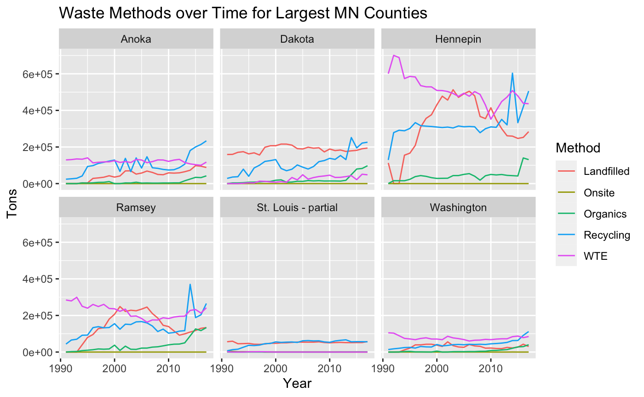
Waste Management Trends: By Method and County
Notes:
Levi
Below is not my script, these are just notes so I don’t forget what I want to talk about for the recording :)
This one is fairly self-explanatory-but here are the insights i found:
There seems not to be any huge trends or much common consistency between counties, but there is something that I’m seeing that’s common. I think I’m seeing a spike at about 2014 in recycling for each of these counties. See next slide:

Slide 4
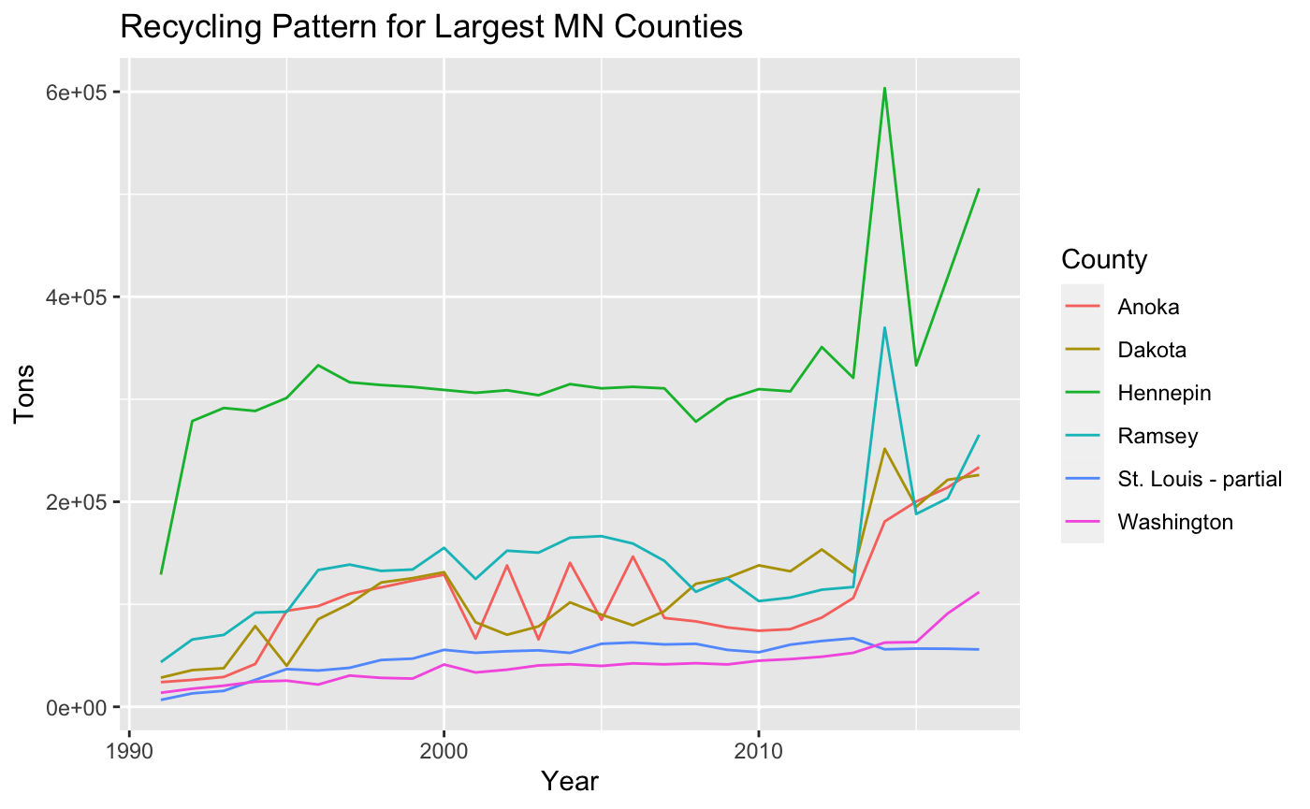
Waste Management Trends: Recycling By County
Notes:
Levi
There seems to be a fairly common spike in recycling in 2014. Why?
It was the first year recycling goals were updated since 1995, I’m guessing there was a push to start working towards the new 2030 goals.

Slide 5
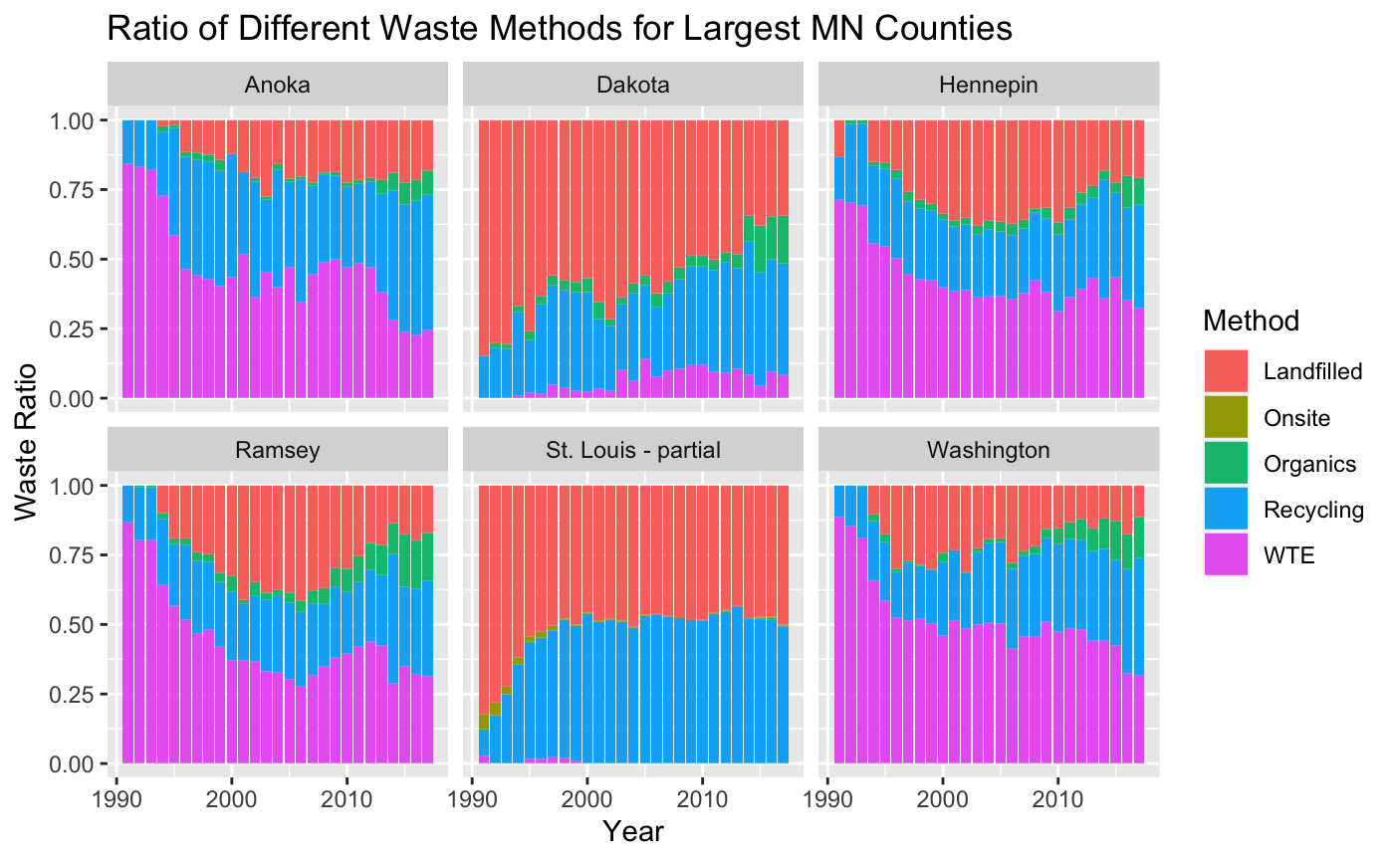
Waste Management Trends: Method Proportion
Notes:
Levi
Here are the ratios of waste methods over time. We are seeing in some counties different curves than others, We are seeing that landfill amount grow in the
Early 2000s and then begin to shrink again. We see organics really pop up around 2010ish, and WTE seems to be decreasing in ratio size as we have more recycling.

Slide 6
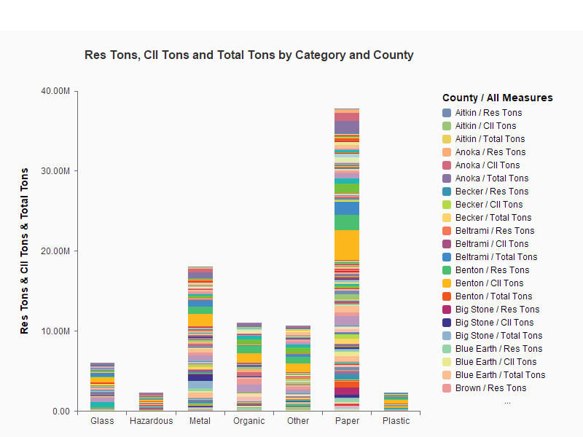
IN THE TRENDS
BAR CHART.
Notes:
Safiyyah Question 2: Are there any different recycling patterns between counties for each type of recycling
category (paper, glass, metal etc.) based on the recycling by category data?
Are the patterns consistent for different types of recycling categories?
PAPER: Corrugated,Magazine/Catalog,Newsprint,Office Paper
METAL: Aluminum,Co-Mingled Alum/Steel/Tin,Other Ferrous & Non-Ferrous,Steel/Tin Cans
GLASS: Food & Beverage,Other glass
PLASTIC: HDPE,Mixed Plastic,Other Plastic,PET
OTHER:
Carpet,Major Appliances,Textiles,Unspecified or Other
ORGANIC: food for people,food for livestock,Yard Waste Composting,Other (Bone/Fat - Rendering or Cooking Oil)
HAZARDOUS: Used oil, Household waste, vehicle batteries

Slide 7
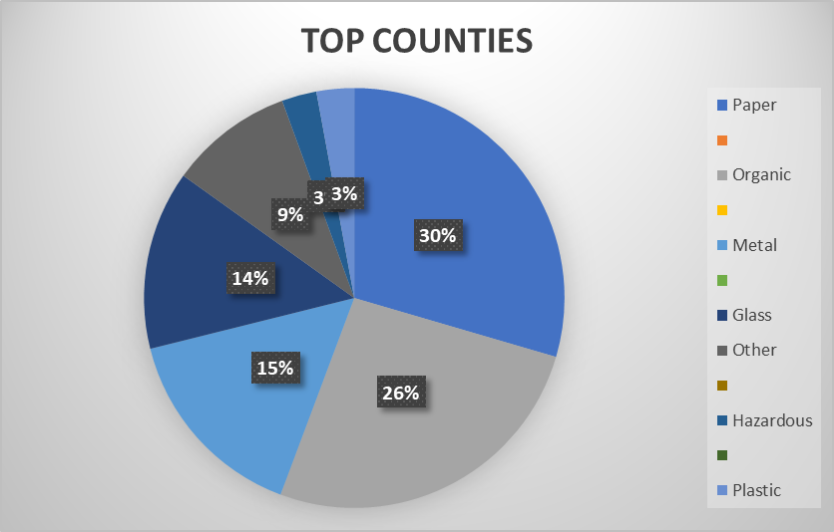
IN THE TRENDS
Organic: 81,331
Paper: 57,400
Metal: 53,224
Glass: 39,298
Other: 18,982
Plastic: 6,934
Hazardous: 4,702
TOP 10 COUNTIES FOR RECYCLING: TOTAL TONS BY CATEGORY
BASED OFF 1991-2017 AVERAGE RECYCLING AMOUNTS PER COUNTY
Notes:
Safiyyah ON AVERAGE PER COUNTY,

Slide 8
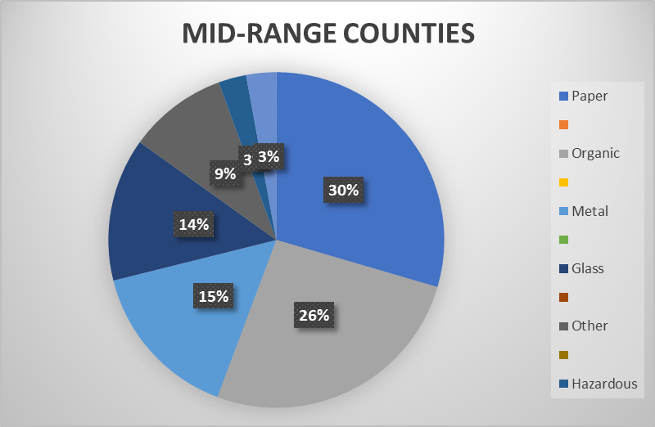
IN THE TRENDS
Paper: 7,577
Organic: 6,714
Metal: 3,952
Glass: 3,538
Other: 2,445
Plastic: 741
Hazardous: 688
TOP 10 COUNTIES FOR RECYCLING: TOTAL TONS BY CATEGORY
BASED OFF 1991-2017 AVERAGE RECYCLING AMOUNTS PER COUNTY
Notes:
ON AVERAGE PER COUNTY

Slide 9
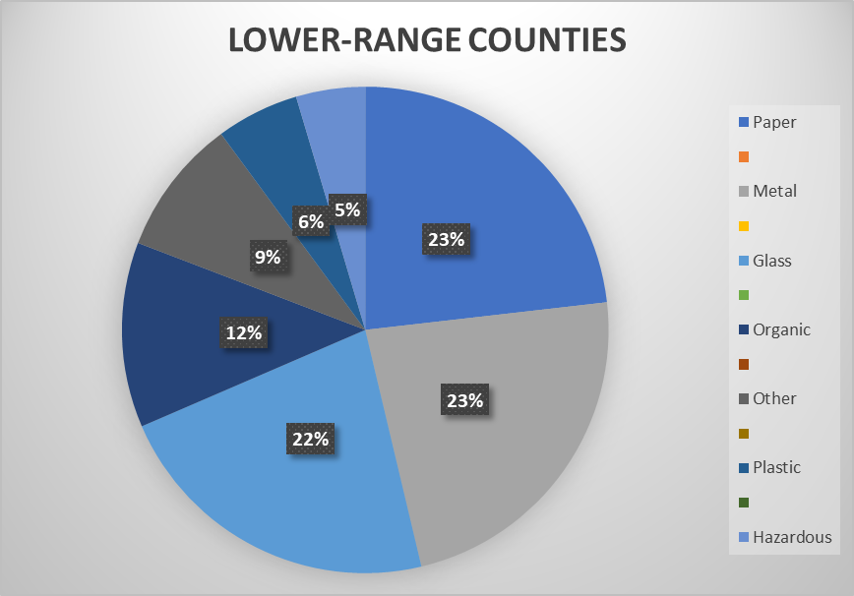
IN THE TRENDS
Paper: 556
Metal: 554
Glass: 533
Organic: 295
Other: 218
Plastic: 132
Hazardous: 110
TOP 10 COUNTIES FOR RECYCLING: TOTAL TONS BY CATEGORY
BASED OFF 1991-2017 AVERAGE RECYCLING AMOUNTS PER COUNTY
Notes:
ON AVERAGE PER COUNTY, in tons.

Slide 10
Question 3
What is the average expenditure by category by year, visually and statistically? Is the expenditure by category statistically meaningful? If so, what did you discover?

Slide 11
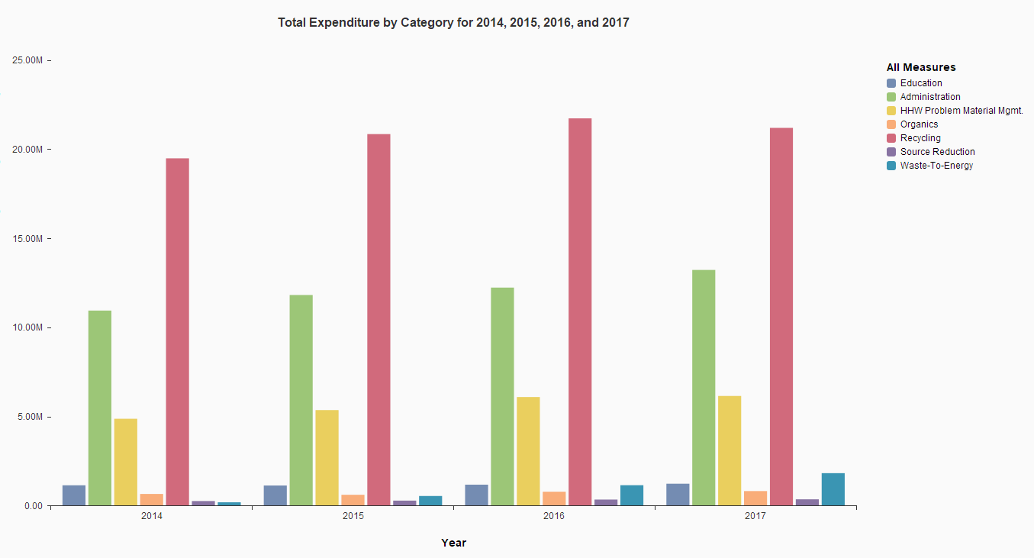
Total expenditure for all categories in years 2014, 2015, 2016, and 2017

Slide 12
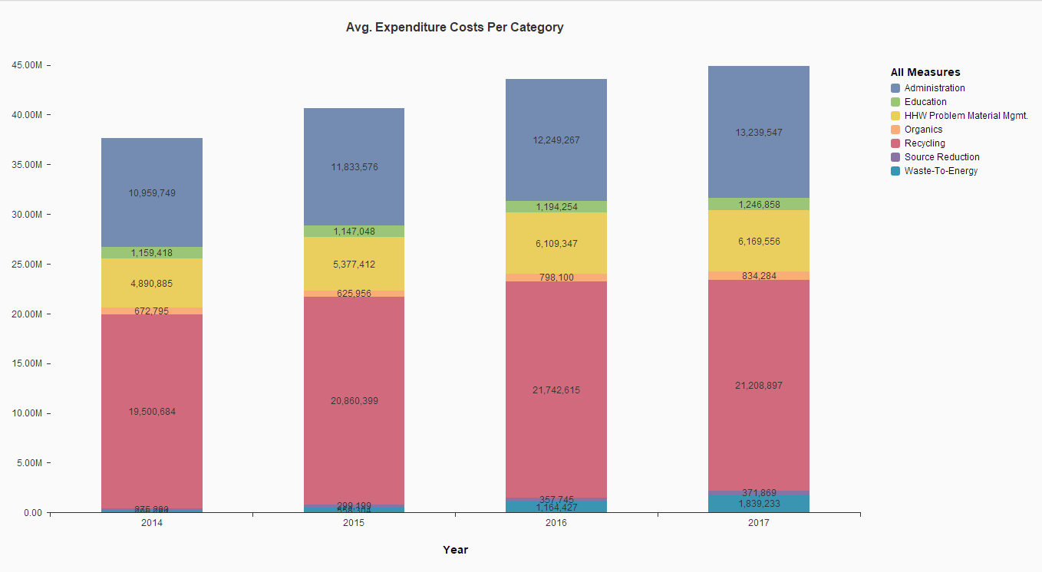
Total expenditure for all categories in years 2014, 2015, 2016, and 2017

Slide 13
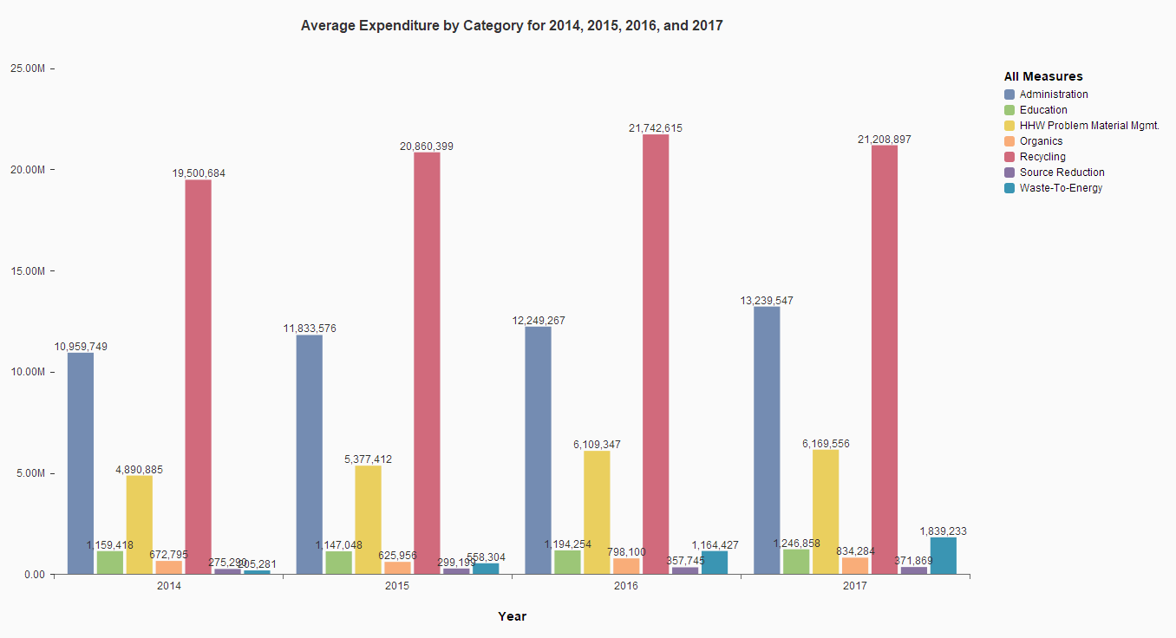
Average expenditure per category for 2014, 2015, 2016, and 2017

Slide 14
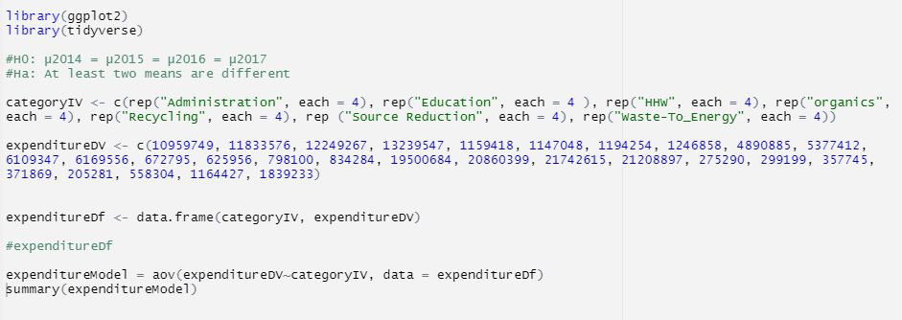
Is there a statistically significant difference in average expenditure?
Now we consider the second part of the question, Is the expenditure by category statistically meaningful?
H0: µAdministration = µEducation = µHHW = µOrganics = µRecycling = µSource = µWaste-To-Energy
Ha: At least two means are different

Slide 15
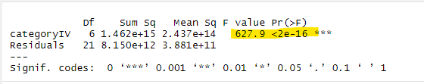
Is there a statistically significant difference in average expenditure?
Now we consider the second part of the question, Is the expenditure by category statistically meaningful?
H0: µAdministration = µEducation = µHHW = µOrganics = µRecycling = µSource = µWaste-To-Energy
Ha: At least two means are different

Slide 16
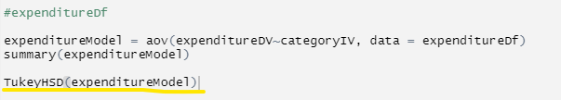
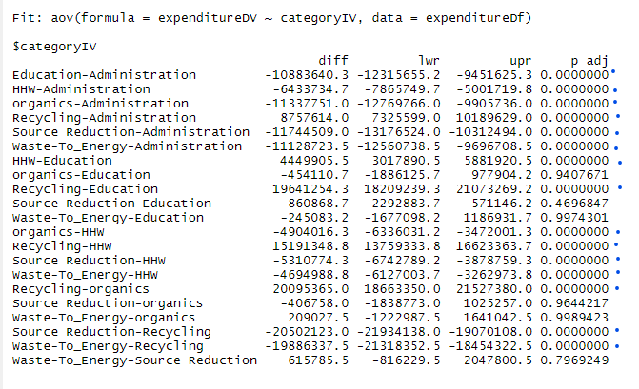
Is there a statistically significant difference in average expenditure?
So, we’ve determined there are significant differences. Where do they lie?

Slide 17
Question 4 - Jeremy
Does the net income (revenue - expenditure) have any impacts on recycling? Is there any correlation between net income and the amount of total recycling?

Slide 18
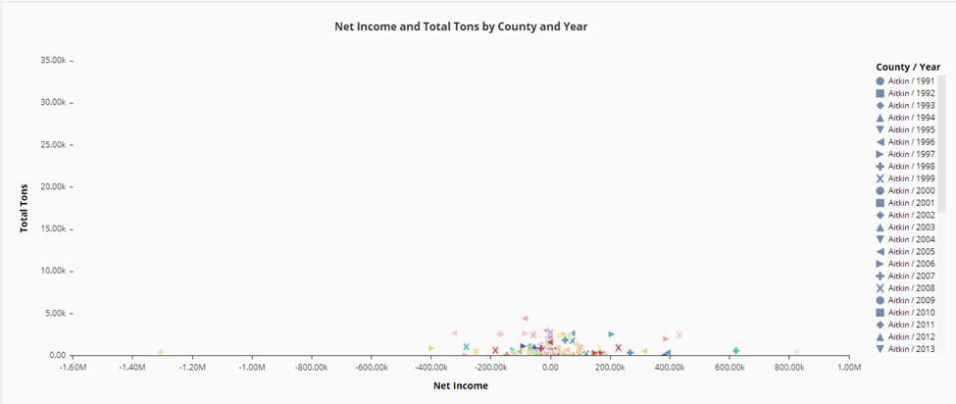
Net Income Vs Tons Recycled Scatterplot

Slide 19
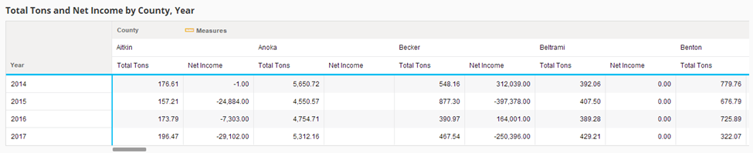
Total Tons and Net Income Text Table

Slide 20
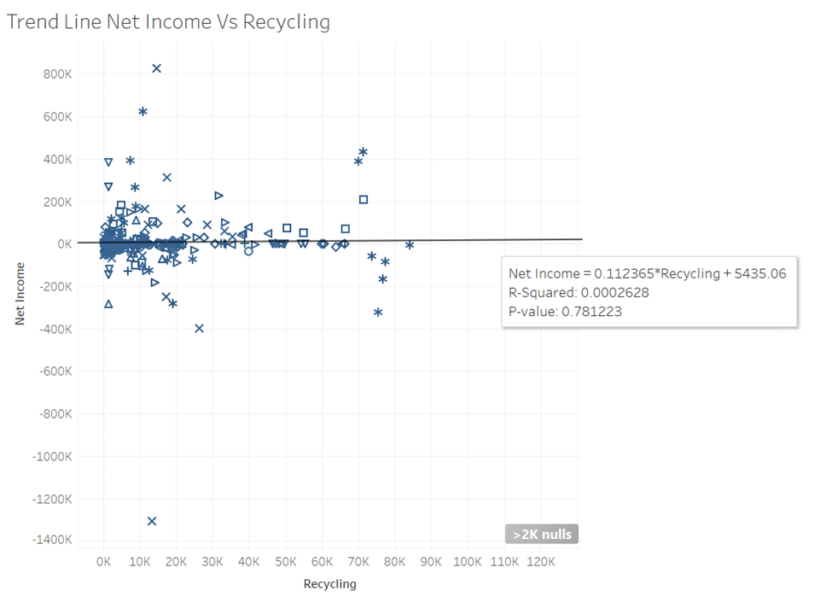
Trend Line: Recycling vs Net Income (County and Year)

Slide 21
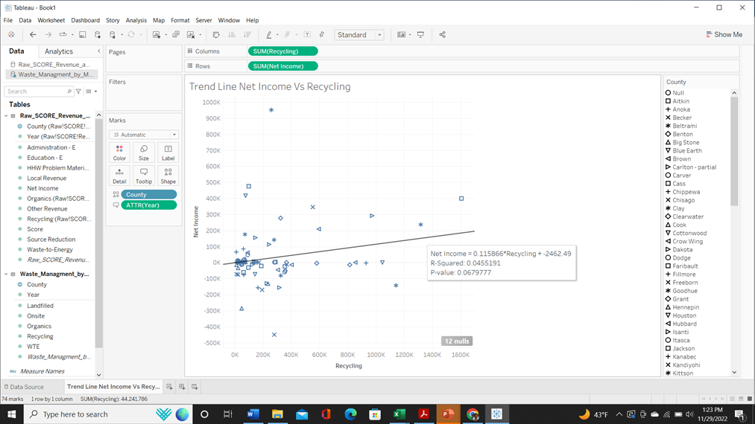
Trend Line: Recycling vs Net Income (County)

Slide 22
Question 5 - Linh, Chris
Perform appropriate visualization to examine patterns in the data related to policy changes in the history of recycling. Part of the history of policy changes were explained in the data overview section. Do research on other possible policy changes matching your findings.

Slide 23
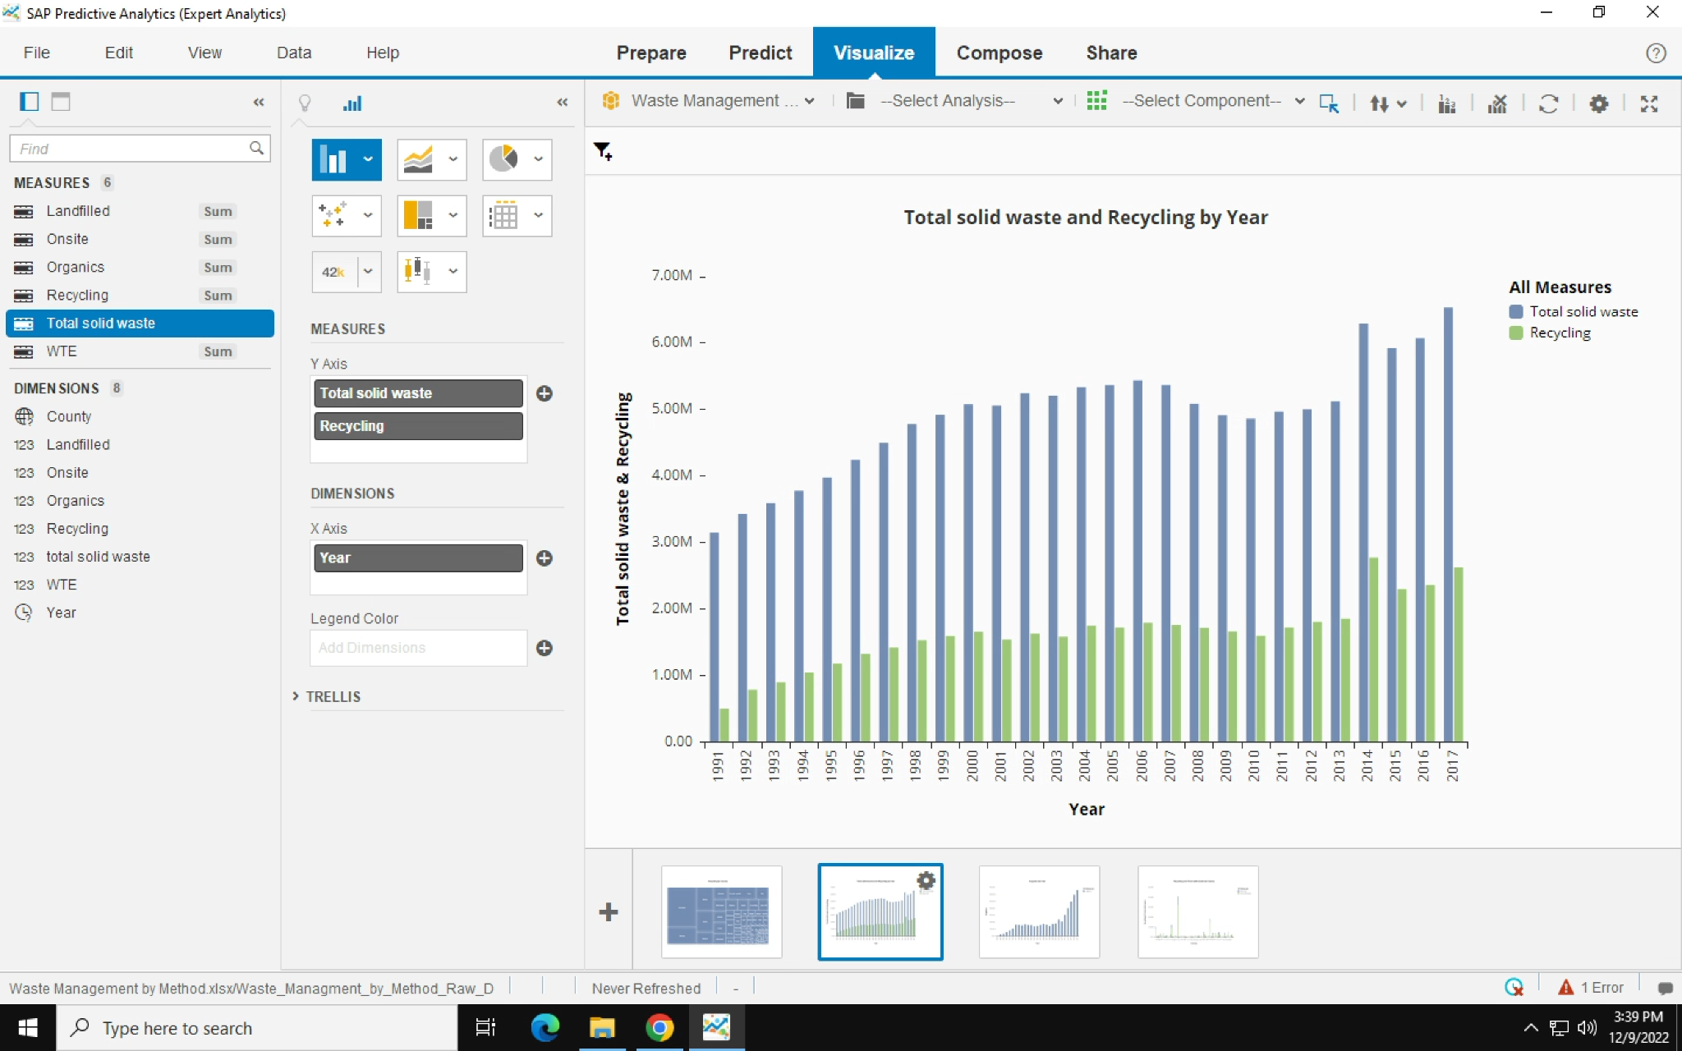
Data Patterns related to policy changes: increasing trend in recycling

Slide 24
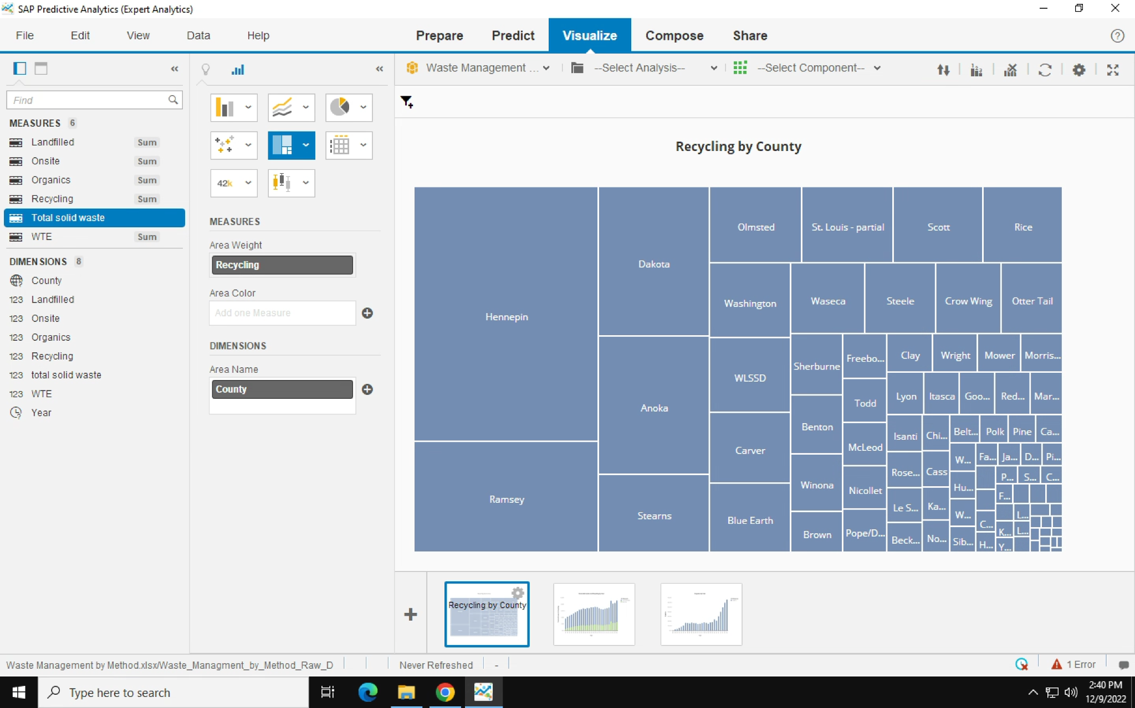
Counties in Metropolitan areas are dominant in recycling materials (in tons)

Slide 25
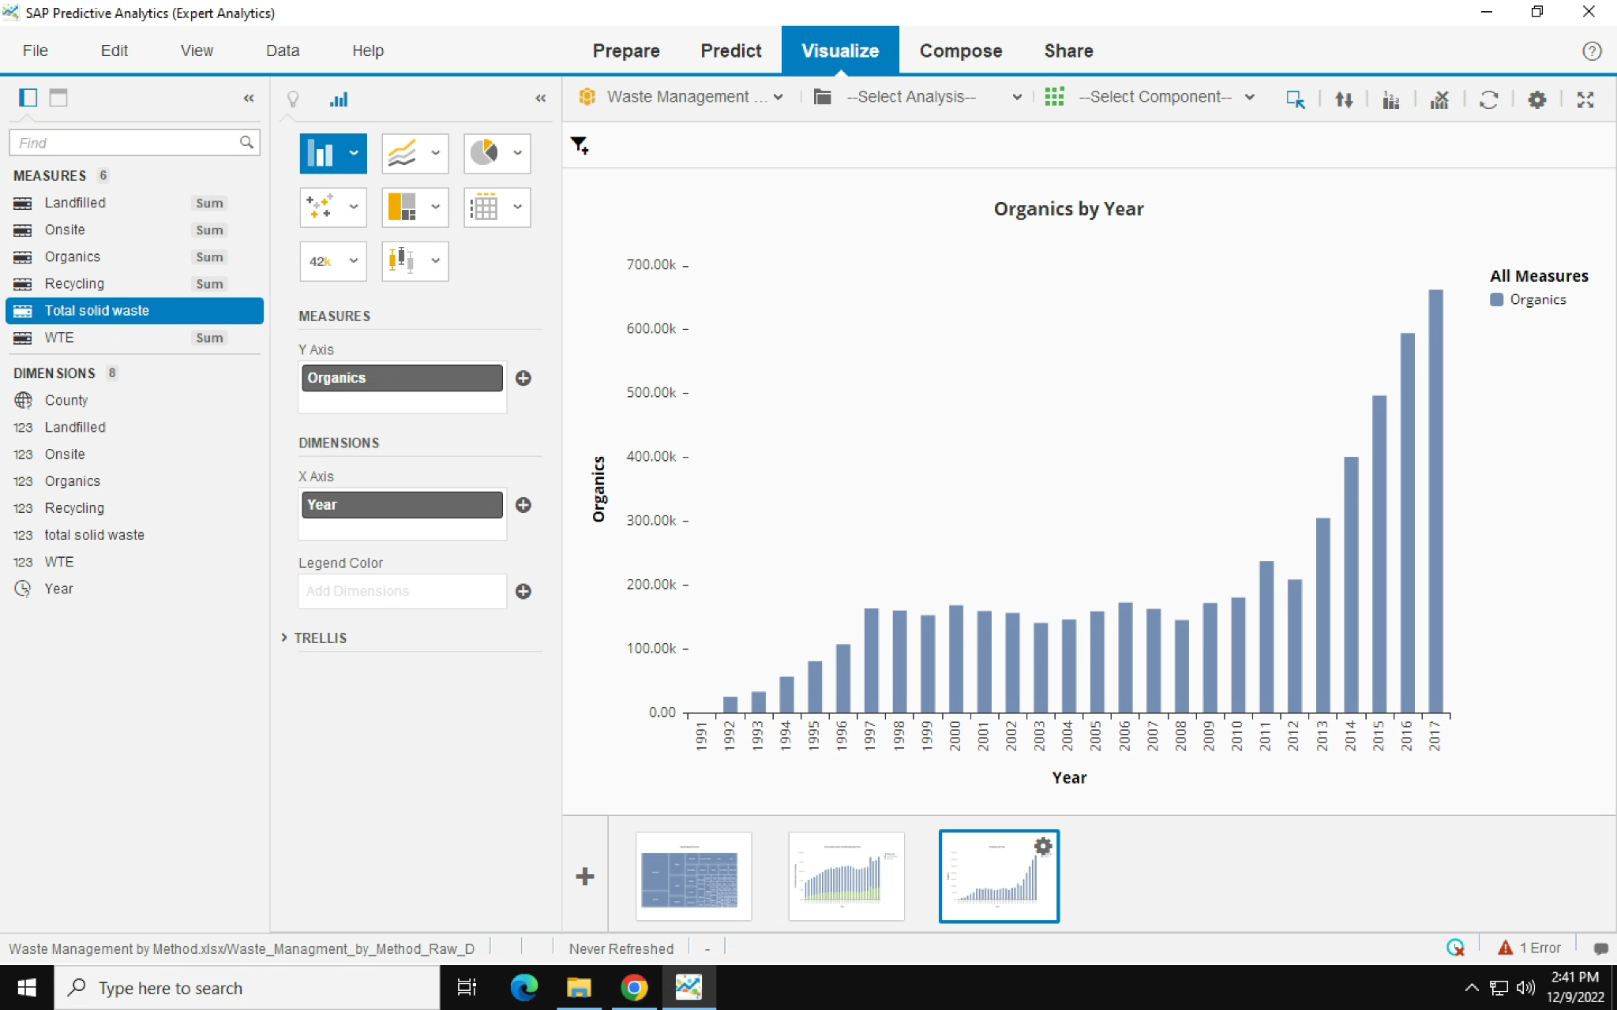
Big Jump in organics recycling

Slide 26
Question 6 - Isak
Do your own research on national recycling data and find the national pattern of recycling (please do not forget about explaining your dataset and source of it). Is that consistent with Minnesota’s pattern?

Slide 27
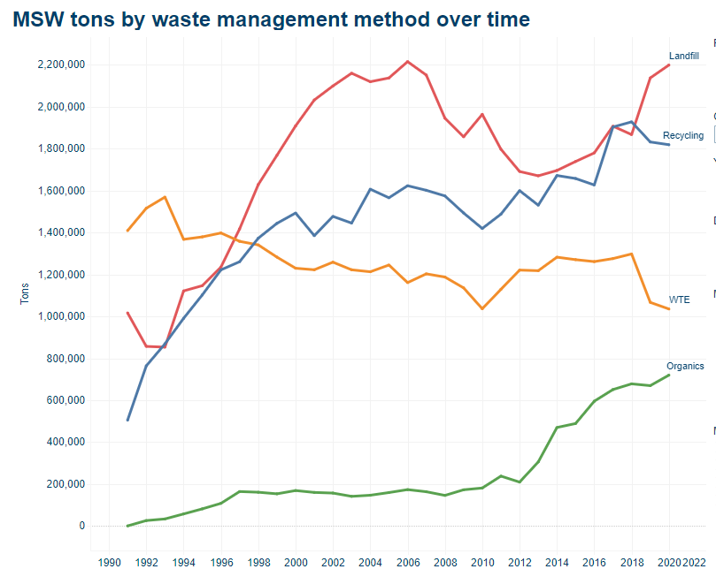
Minnesota waste management over time

Slide 28
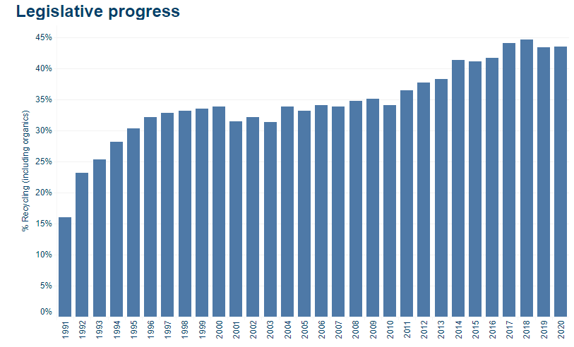
Minnesota Yearly Recycle Percentage

Slide 29
References
Slide 6, Website: Minnesota Department of transportation: Article: Municipality, Township & County Maps
Web Address: https://www.dot.state.mn.us/maps/gdma/mapfinder.html
Slide 7, Website: Minnesota Demographics by Cubit Article: Minnesota Counties by Population
Web Address: https://www.minnesota-demographics.com/counties_by_population
Slide 26 & 27, Website: Minnesota Pollution Control Agency
Web Address: https://public.tableau.com/app/profile/mpca.data.services/viz/SCOREOverview/1991-2018SCORE

